Slide 1
IBM Capstone Project

Slide 2
Business Problem
Identifying the ideal location for a new Steakhouse in Toronto.
The success of the business will be largely dependent on the location of the restaurant within the city, therefore data will be collected on all local businesses to find the ideal blend of surrounding venues to compliment the restaurant.

Slide 3
Data Acquistion & Cleaning
Data Required:
Location data including towns, boroughs and geographical coordinates, web scraped from wikipedia
Foursquare API data including nearby venues split into business categories.
Removing nulls and cleaning unstructured string data

Slide 4
Clusters
Cluster 0: Contains a single location, with a varied array of venues, mostly low spending shops.
Cluster 1: This clusters contains the majority of the locations analysed. With a wide variety of venues but predominately food and drink venues, restaurants in particular.
Cluster 2: Contains a duplicate of Cluster 0. The exact same values.
Cluster 3: Most common venue is parks followed by convenience stores and other small shopping facilities.
Cluster 4: Contains a high influence of parks, rivers, dog runs, gyms and discount store. This shows a low consumer spending budget and consists of more leisure and activities.
Cluster 5: Contains a single value, consisting of fast food venues and discount stores.
Cluster 6: Contains two values, consisting of fast food discount stores and in particular two baseball fields.

Slide 5
Results
The visual distribution of the clusters is somewhat varied, there is no single cluster which sits in a particular location, apart from the clusters with a single value. The one slight exception to this is cluster 1, which is spread entirely across Toronto but does form a slight concentration of data points at the ‘Lake Shore Boulevard’ this would indicate the area has a high consistency with that of cluster 1s features. Thereby creating a wide variety of venues with the same business, attracting the same customers and giving them more variety in terms of competition, which further fuels the incentive of the consumer to visit the area.

Slide 6
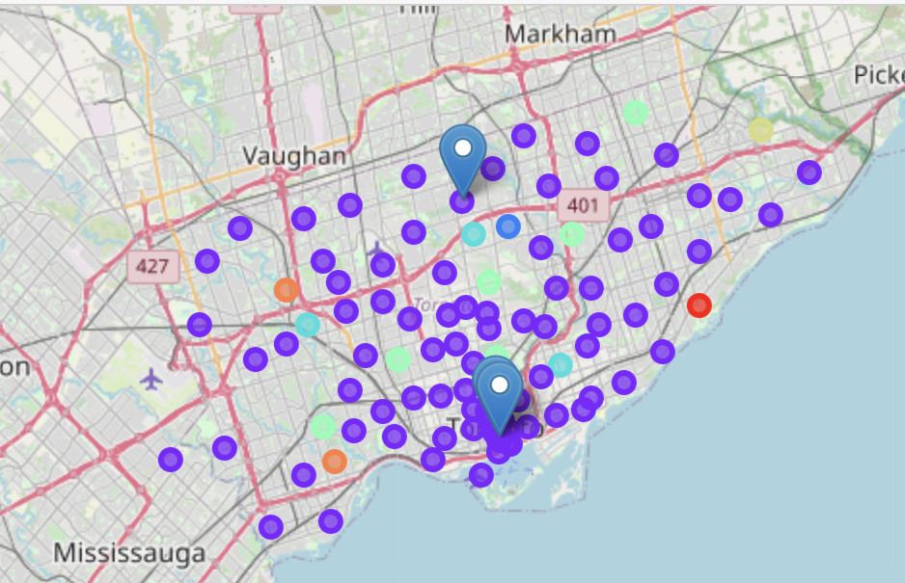
Map
The drop points show the locations where Steakhouses were within the top 10 locations.

Slide 7
Conclusion
To conclude, the cluster 1 produced the desired venues fit for the location of the new steakhouse restaurant, high spending venues in hospitality and food and drink. This is validated by the fact three existing steakhouse venues (that made it into the top 10 venues per location) also classified into this cluster.
I would recommend opening the Steakhouse restaurant in 'Lake Shore Boulevard' because it had the highest concentration of cluster 1 locations, offering a variety in terms of shops and competition, which further fuels the incentive of the consumer to visit the area.

